Slide 1
Assignment cover sheet
Student’s name | Lee | Palmer
Module name | Professional Practice and Portfolio Development 1 (QAC020C126SS)
Title of assignment | PPPD End-of-module Assessment
Complete Word Count in my assignment
Date submitted
All work must be submitted by the due date. If an extension of time to submit work is required, a Mitigating Circumstances Extension Form must be submitted.
Has an extension been approved? No (delete as appropriate)
If yes, please give the new submission date ….…/..…./…….

Slide 2
Academic Integrity Statement
IMPORTANT: THIS STATEMENT MUST BE READ & SIGNED
Academic integrity and honesty are fundamental to the academic work you produce at the University of Roehampton. You are expected to complete coursework which is your own and which is referenced appropriately. The university has in place measures to detect academic dishonesty in all its forms. If you are found to be cheating or attempting to gain an unfair advantage over other students in any way, this is considered academic misconduct and you will be penalised accordingly.
I declare that the work I am submitting is my own work, is properly referenced and has not been submitted elsewhere.
Student Signature (Full Name):
Date:

Slide 3
Task 1

Slide 4

The Problem / Challenge
I joined a new transport safety system project.
It was done to replace the slow, outdated current version.
The project was not going well.
I was to solve some of the application’s issues.
The team worked in an agile way.
Using daily scrum meetings and retrospectives.
R M Media Ltd, no date
Notes:
Discuss how the CPD training you selected has aided you to address a project or problem within the workplace. Introduce the project or problem you chose and review how your CPD training was related to it.
I'd like to share my experience with a recent project at Fujitsu. We were tasked with developing a new digital safety system for a major transport company. This project aimed to replace an outdated system, allowing employees to report and track safety issues more efficiently.
I joined the team at a difficult point. The project was behind schedule and faced significant technical challenges, including accessibility and error handling. As a junior software developer, I was brought in to help address these issues and get the project back on track.
Our team operated using agile methodologies. This meant daily scrum meetings to discuss progress and obstacles, tasks assigned by our scrum master, and fortnightly retrospectives to reflect on our work and improve our processes.

Slide 5


My Technical Learning
The project used the Power Platform stack
I was new to this technology, so needed to upskill myself.
I used online resources to learn the technical and practical knowledge.
I also took Microsoft’s official PL-100 and PL-200 certification exams and passed!
Microsoft, 2024b
Microsoft, 2024a
Notes:
The project primarily used Microsoft's Power Platform, particularly Canvas Apps and Power Automate.
As this technology was relatively new to me, I needed to quickly enhance my skills to meet the project's needs.
I began to upskill myself in this new tech stack. I used different resources, including Microsoft Learn courses, online video tutorials, and industry blogs.
I also pursued and successfully obtained two key certifications: the PL-100 and PL-200. These certifications validated my skills and demonstrated my dedication to professional growth.
The PL-100, or Microsoft Power Platform App Maker, certification validates the ability to build low-code solutions that simplify business processes.
The PL-200 demonstrates proficiency in configuring and implementing more complex Power Platform solutions.
These certifications provided me with an understanding of the Power Platform ecosystem, which was needed on my project.

Slide 6
Task 2

Slide 7
Why Reflection is required
Reflection helps IT professionals learn from experience:
By looking back on past projects and decisions, I can spot what worked well, what didn’t and avoid repeating mistakes
Reflection keeps IT professionals adaptable in a fast-changing field:
Thinking about current practices can help me identify areas where I need to update my knowledge
This mindset of constant learning will help me stay current with new technologies and industry trends

Slide 8

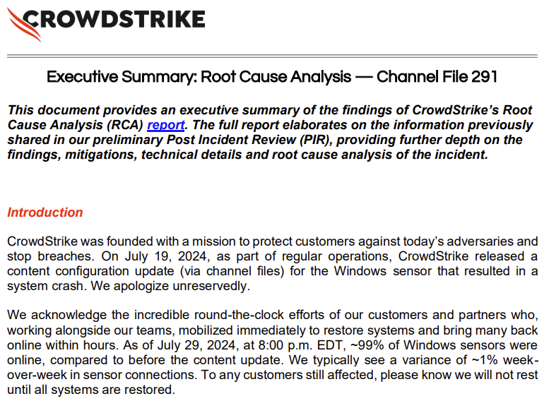
Example
Robins-Early, 2024
CrowdStrike, 2024
Notes:
The importance of reflections is shown by the recent CrowdStrike debacle. In response, CrowdStrike completed a forensic reflection on what caused the issue and hoo they will improve going forward.

Slide 9
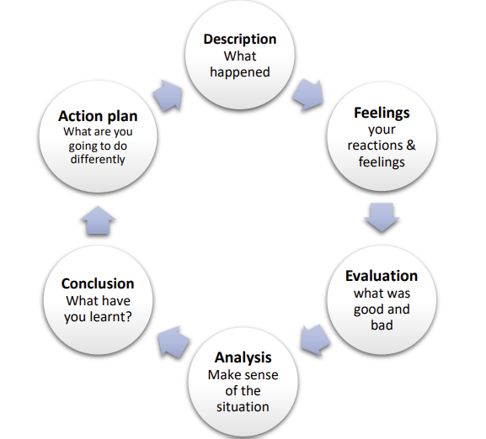
Model of Reflection used and why
I chose Gibb’s reflective cycle because:
Systemic thinking
Addressing feelings
Re-usability
University of Cumbria, 2020
Notes:
The model of reflection I have chosen to use is Gibbs’ reflective cycle as it provides a clear and well-structured approach to continuous learning.
I have chosen this models over other reflective models for several reasons, including:
The Gibbs’ model consists of a systematic thinking, which is a similar approach I use when working as a software developer – taking a larger problem and breaking it down into smaller, manageable chunks.
The Gibbs’ model includes an element of examining feelings, which two others (O’Driscoll’s WHAT and In/On action models) do not address. I feel this is an important step to acknowledge when challenges can lead to frustrations or stress and how to deal with these emotions moving forward.
Gibb’s model can be applied repeatedly to the same situation which is like sprint cycles in Agile. This was an interesting similarity as I talk about my first experiences with Agile in this presentation.

Slide 10
Key Reflection Points
Description (already covered)
Feeling
Nervous as a beginner
Vulnerable during standups
Evaluation
Accessibility Tasks ✅
Error Handling ❌
Notes:
Gibbs Model:
Description
Already described previously
Feeling
During my time on the project, I felt nervous as a newcomer, both to working as a professional software developer and a newcomer to the tech stack.
I particularly felt vulnerable during the daily standups, as I felt I had to constantly justify myself being on the project.
Evaluation
What was good is that I completed most of the tasks I was set, which included fixing hundreds of accessibility errors.
What did not go so well was I could not complete some of the error handling tasks set for me, as it involved modifying complex code while keeping the functionality.

Slide 11
Key Reflection Points
Analysis:
My CPD training covered the accessibility requirement tasks.
Did not have the required skills to handle complex SQL queries or agile experience.
Conclusion:
I now understand what an agile/scrum environment involves.
I can now solve accessibility issues within Power Platform Applications.
Action Plan
Speak up earlier when I am stuck
Continue Power Platform development
Notes:
Analysis
Why did it go well on the accessibility tasks? Through my certification leaning as well as reading the official White Paper from Microsoft about developing Power Apps before starting the project, which described best practices for achieving high standards for accessibility.
What didn’t go well was due to my lack of experience, both with the agile process and how it works, as well as my lack of proficiency with complex programming languages involving SQL queries.
Conclusion
Now, I understand that a standup is to discuss both project and individual progress as well as to identify any blockers, so I should have been more relaxed and less worried about how I appeared.
I can now solve accessibility issues within Power Platform Applications.
Action Plan
In future, I will speak up earlier in standups when I am stuck on an issue and extra help is needed.
I will also continue my Power Platform learning to be able to solve complex coding issues in big applications in the future.

Slide 12
Task 3

Slide 13
Key Professional and Personal Skills
BCS Code of Conduct (Bott, 2005, pp. 8–20):
Public Interest
Professional Competence and Integrity
Duty to Relevant Authority
Duty to the Profession
Notes:
For task 3, I must justify how my personal development has supported my development as a professional. It can be difficult to define what is an IT professional, as there is no required membership to be part of.
I have chosen the British Computing Society’s Code of Conduct as a standard to compare myself to, which are put into the above four categories.

Slide 14
Cultural and Individual Responsibilities

Slide 15
References

Slide 16
Bibliography

Slide 17
Discussion / Q&A

